Slide 1
JavaScript - UFO hunter game Playing Boundaries

Slide 2


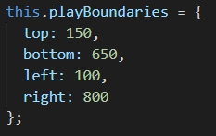
The active playing field
The active playing field within the canvas is delimited
900 px
0
700 px
top: 150
500 px
bottom:
650
750 px
left: 100
right: 800
Canvas

